Slide 1
Building the RISC-V Education EcosystemA Systematic Educational Contents Design, Remote Laboratories, and Community-Driven Learning
Author：Yunxiang Luo,Fuyuan Zhang,Tianwei Jiang ,Zhi Li,Hang Zheng,Xirui Hao
Institute of Software, Chinese Academy of Sciences (ISCAS)

Slide 2
Core Issues in RISC-V Education
01
02
03
Talent Shortage and Fragmented Resources
Dispersed Community and Collaboration
Proposed Systematic Solution
Skilled professionals are in short supply, with fragmented curriculum resources leading to low learning efficiency. High- quality educational content is scarce, and insufficient experimental equipment hampers programming capabilities.
The technical community is dispersed, with weak collaboration, slowing knowledge exchange and learner retention. An active, centralized learning community is absent, which is crucial for accelerating RISC- V education.
A systematic educational solution is proposed, including curriculum development, experiment environment support, and community engagement. This solution aims to address the core issues and build a robust RISC- V education ecosystem.
Notes:
To address these challenges, a systematic educational solution is proposed,
encompassing tree dimensions: curriculum development, experiment environment support, and community
engagement. In curriculum design, collaboration occurs with our laboratory, community developers, and
university teachers to construct a multi-tiered course system spanning from foundational theories to cutting-
edge technologies. A quality assurance mechanism is established through weekly technical seminars to form a
course quality grading methodology ensuring continuous refinement of educational content. In order to
address the challenge posed by hardware resource limitations, a strategy of integrating laboratory facilities
across multiple regions in China has been adopted, with the aim of establishing a remote experimental
environment that supports diverse RISC-V boards. This approach has the effect of significantly lowering
barriers to RISC-V experimental environment access. Furthermore, an active community is cultivated,
reaching over 30,000 participants through Bilibili and WeChat communities, regular offline technical
workshops, and RISC-V programming competitions, fostering learner engagement and technical identity. The
results demonstrate that this solution has produced over 1,000 original instructional videos, which have
accumulated more than 1.3 million views. This systematic approach not only addresses critical educational
gaps but also provides a scalable model for nurturing talent in emerging technologies, thereby accelerating the
integration of RISC-V into innovation landscape

Slide 3
Underdeveloped Educational Ecosystem
Fragmented Materials and Limited Hands-on Opportunities
Absence of Active Learning Community
Need for a Comprehensive Approach
RISC- V educational materials are fragmented, lacking clear progression from fundamentals to real- world applications. Limited hands- on experimentation opportunities for students due to high costs and limited availability of development boards.
The absence of an active, centralized learning community slows knowledge exchange and learner retention. This hinders the widespread adoption and application of RISC- V technology.
A comprehensive approach is needed to bridge the gap between RISC- V's technical potential and the practical need for scalable education. This includes structured curriculum pipelines, remote hardware access, and an active learner community.

Slide 4
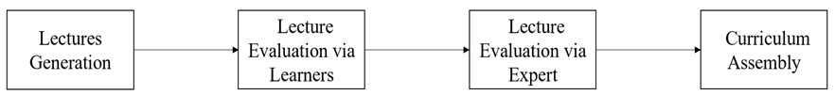
Three-pronged Approach
Curriculum Development
Remote Laboratory Infrastructure
Community-Driven Engagement
Develop a structured curriculum to provide a clear learning path for RISC- V education. Ensure the curriculum covers both theoretical foundations and practical applications.
Build a distributed remote laboratory environment to provide hands- on experimentation opportunities. Integrate RISC- V boards and ensure compatibility with various operating systems.
Cultivate a hybrid online- offline community to facilitate knowledge exchange and collaboration. Provide tutorials, Q&A forums, live coding sessions, and offline workshops.
Notes:
To address the challenges identified in RISC-V education and ecosystem development, we propose a threepronged approach encompassing curriculum development, remote laboratory infrastructure, and community-driven engagement.

Slide 5
Four-stage Systematic Workflow
02
01
03
Lecture Evaluation
Lecture Generation
Evaluate lectures through learners' feedback on Bilibili.com. Use a scoring rubric to assess lecture quality and make improvements.
Structured Curriculum Assembly
Weekly seminars with laboratory researchers, community developers, and university teachers. Generate high- quality lectures covering various aspects of RISC- V technology.
Assemble the evaluated lectures into tiered modules. Ensure the curriculum has a logical progression and covers both basic and advanced topics.
Notes:
The curriculum design process follows a systematic four-
stage workflow, referencing Figure 1, ensuring quality
control and adaptability to evolving technological trends.
First of all is the lecture generation, weekly seminars are
conducted with laboratory researchers, community
developers, and university teachers to identify high-impact
projects and translate them into lectures. These sessions
produce hands-on tutorials, and lecture videos.

Slide 6
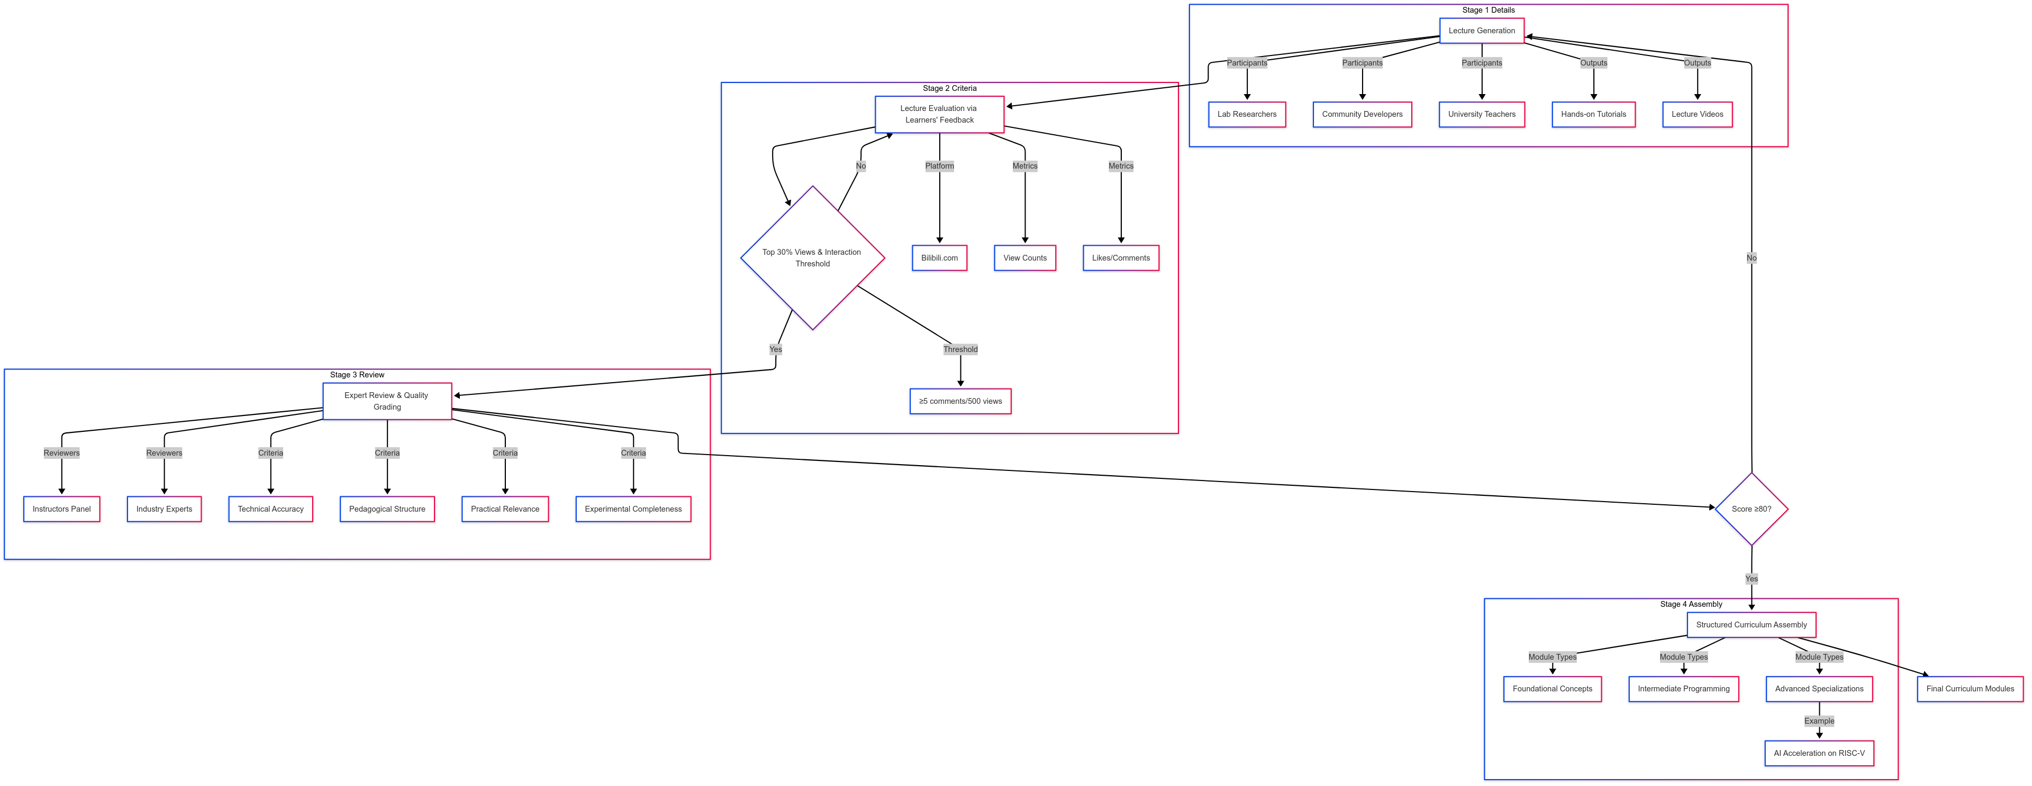
Four-stage Systematic Workflow

Slide 7
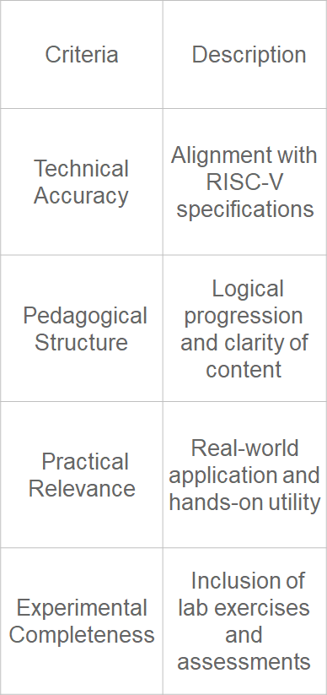
Evaluation Rubric
Pedagogical Structure
Assess the logical progression and clarity of content. Ensure the course is well- organized and easy to follow.
Technical Accuracy
Ensure the course content aligns with RISC- V specifications. Verify the accuracy of technical details and concepts.
Practical Relevance
Evaluate the real- world application and hands- on utility of the course. Include lab exercises and assessments to enhance practical skills.
Notes:
The second
step is lecture evaluation via learners’ feedback, all lectures
are published on Bilibili.com, where learner engagement
metrics (e.g., view counts, likes, comments) are monitored.
Videos ranking in the top 30% of views and meetingpredefined interaction thresholds (e.g. \(≥5\) comments per 500 views) proceed to formal review. The third step is expert review and lecture quality grading, a panel of instructors and industry experts evaluates shortlisted materials using a scoring rubric, referencing Table 1. Criteria include technical accuracy, pedagogical structure, practical relevance, and experimental completeness. Courses scoring ≥80 are certified for integration into the formal curriculum. The last step is structured curriculum assembly, the approved courses are organized into tiered modules, spanning foundational concepts, intermediate programming topics, and advanced specializations (e.g., AI acceleration on RISC-V).

Slide 8
Distributed Environment
01
02
03
Multi-region Integration
Access Architecture
Firmware and OS Compatibility
Integrate RISC- V boards across multiple regions, including Beijing, Nanjing, and Shanghai. Use boards like HiFive Unmatched and Licheepi4A to provide diverse experimentation options.
Implement SSH and VNC protocols for secure access. Use a jump server for secure authentication and smart power outlets for remote power cycling.
Develop SD Mux devices for automated firmware flashing. Ensure compatibility with various RISC- V operating systems.
Notes:
To mitigate RISC-V laboratory infrastructure accessibility barriers, a distributed remote lab environment was established across Beijing, Nanjing, and Shanghai, referencing Figure 2, Key components include multi-region RISC-V boards integration, access architecture, and Operating System support. The physical RISC-V development boards (e.g., HiFive Unmatched, Licheepi4A) are pooled from our labs and community contributors, enabling shared access via remote protocols. Users connect through SSH and VNC protocols, facilitated by a jump server for secure authentication. Smart power outlets enable remote power cycling, while SD Mux devices automate firmware flashing (e.g., using SDWireC for unattended SD card programming). A compatibility RISCV Operating System Matrix ensures seamless integration of diverse RISC-V boards with Linux distributions (e.g., Fedora RISC-V, Debian) and real-time operating systems (e.g., FreeRTOS).

Slide 9
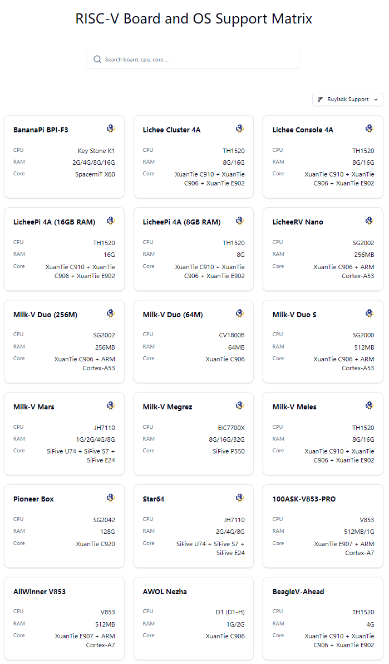
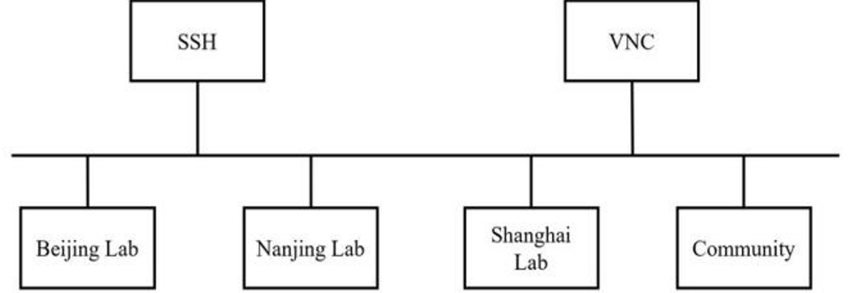
Distributed Environment
56 types of RiSC-V Boards
41 types of Operating Systems
supported by https://matrix.ruyisdk.org/
Notes:
To mitigate RISC-V laboratory infrastructure accessibility barriers, a distributed remote lab environment was established across Beijing, Nanjing, and Shanghai, referencing Figure 2, Key components include multi-region RISC-V boards integration, access architecture, and Operating System support. The physical RISC-V development boards (e.g., HiFive Unmatched, Licheepi4A) are pooled from our labs and community contributors, enabling shared access via remote protocols. Users connect through SSH and VNC protocols, facilitated by a jump server for secure authentication. Smart power outlets enable remote power cycling, while SD Mux devices automate firmware flashing (e.g., using SDWireC for unattended SD card programming). A compatibility RISCV Operating System Matrix ensures seamless integration of diverse RISC-V boards with Linux distributions (e.g., Fedora RISC-V, Debian) and real-time operating systems (e.g., FreeRTOS).

Slide 10
Hybrid Online-Offline Community
01
02
03
Online Platforms
Offline Activities
Community Building
Host over 30,000 participants on Bilibili and WeChat platforms. Provide tutorials, Q&A forums, and live coding sessions to engage learners.
Organize offline workshops and annual RISC- V programming competitions. Create pathways to training and industry opportunities for learners.
Foster a strong sense of community and collaboration among learners. Encourage knowledge sharing and continuous learning.
Notes:
To foster collaboration and engagement, a hybrid onlineoffline community was cultivated. The community has Bilibili and WeChat host over 30,000 participants, offering tutorials, Q&A forums, and live coding sessions. Offline workshops and annual RISC-V programming competitions provide training and job opportunities.

Slide 11
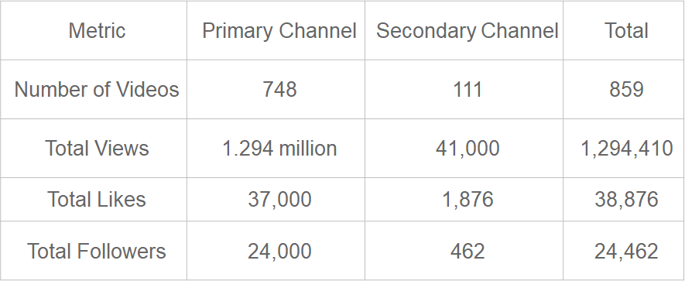
Data from Bilibili.com Channels
Channel Statistics
Impact and Reach
Combined statistics from two channels: 859 videos, 1,294,410 total views, 38,876 likes, and 24,462 followers. Popular series include "RISC- V Software Porting and Optimization Championships," "KSCO's Hands- on RISC- V High- Performance Simulator," and "From Scratch: Writing a RISC- V Compiler."
The channels have a significant impact, reaching a large audience and providing valuable learning resources. The popular series attract a high number of views and likes, indicating their relevance and usefulness.
Notes:
The success of this initiative is evident from the engagement metrics on platforms such as Bilibili.com, referencing Table 2. The primary channel, comprising 748 videos, has garnered 1.29 million views, 37,000 likes, and 24,000 followers. Notable series include "RISC-V Software Porting and Optimization Championships," "KSCO's Hands-on RISC-V High-Performance Simulator," and "From Scratch: Writing a RISC-V Compiler." A second channel, comprising 111 videos, has garnered 41,000 views, 1,876 likes, and 462 followers, featuring series such as "RISC-V Computing Floating Bridge" and "WiringX for Milk-V Duo.”

Slide 12
Project Showcase
Understand RISC-V
Arduino for Milk-V Duo
WiringX for Milk-V Duo
[Project link] BiliBili release video acount address
[Project link] Arduino for Milk-V Duo integrates the Arduino ecosystem with Milk-V Duo RISC-V boards, allowing developers to program RISC-V hardware using familiar Arduino frameworks, significantly reducing the learning curve for RISC-V architecture.
[Project link] A hardware abstraction library for Milk- V Duo, simplifying hardware access and programming.
Floating Bridge for RISC-V Computing
YOLO for Milk-V Duo
[Project link] A bridge for RISC- V computing, facilitating communication and data transfer between different systems.
[Project link] YOLO for Milk-V Duo implements the efficient object detection algorithm YOLO (You Only Look Once) on the Milk-V Duo RISC-V development board.

Slide 13
Bridging the Gap
Comprehensive Model for Talent Development
Lowering Entry Barriers and Accelerating Innovation
This initiative bridges the gap between RISC- V's technical potential and the practical need for scalable education. By combining structured curriculum pipelines, remote hardware access, and an active learner community, we offer a reproducible model for global RISC- V talent development.
Our approach lowers the entry barrier for new learners, making RISC- V education more accessible. It also accelerates innovation by enabling hands- on application of next- generation processor technologies.
Notes:
This initiative bridges the gap between RISC-V's technical potential and the practical need for scalable education. By combining structured curriculum pipelines, remote hardware access, and an active learner community, we offer a reproducible model for global RISC-V talent development. Our approach not only lowers the entry barrier for new learners but also accelerates innovation by enabling hands-on exploration of next-generation processor technologies.

Slide 14

Contact Information
Bilibili Channel1
Bilibili Channel2
OS Matrix

